Slide 1

Handovers in LTE: Ensuring Seamless Connectivity
Handovers in LTE (Long-Term Evolution) networks play a critical role in maintaining uninterrupted communication as users move between cells. This presentation will explore the challenges, design methods, and implementation of a predictive model to ensure successful handovers.
Pa
Prakash Kumar Pawar

Slide 2

Problem Definition: Extracting Handover Data from field Log
1
Data Extraction
2
Handover Prediction
Extract key parameters from CU (Central Unit) debug logs, including CELL_ID, CRNTI, SRC_RSRP, SRC_RSRQ, and Target_RSRP.
Develop a model to predict whether a handover will be successful or not based on the input data.
3
Improving Connectivity
Use the predictive model to proactively manage handovers and enhance overall network performance.

Slide 3
Design Methods: Supervised Learning Approach
Data Preprocessing
Feature Engineering
Model Selection
Get CU dbg logs
Evaluate and select the most appropriate supervised learning algorithm, e.g., logistic regression, decision trees, or neural networks.
Retrieve CU debug logs in text format, with a size ranging from 600 to 700 MBs.
Clean and preprocess the CU debug log data, handling missing values and outliers.
Identify and extract relevant features from the data, such as signal strength trends and cell transition patterns.

Slide 4

Project Breakdown: Classification Model
Data Gathering
1
Retrieve the CU debug logs and save them in a text file.
2
Feature Extraction
Using regular expressions, extract the following features from the logs: CELL_ID, CRNTI, SRC_RSRP, SRC_RSRQ, and Target_RSRPn.
Data Preprocessing
3
Check for missing values in the extracted features and handle them through imputation or removal.
4
Feature Selection
Select the most relevant features for the classification model.
Model Training
5
Train the classification model using the preprocessed data.
6
Model Evaluation
Evaluate the performance of the trained model using metrics such as accuracy, precision, and recall.

Slide 5
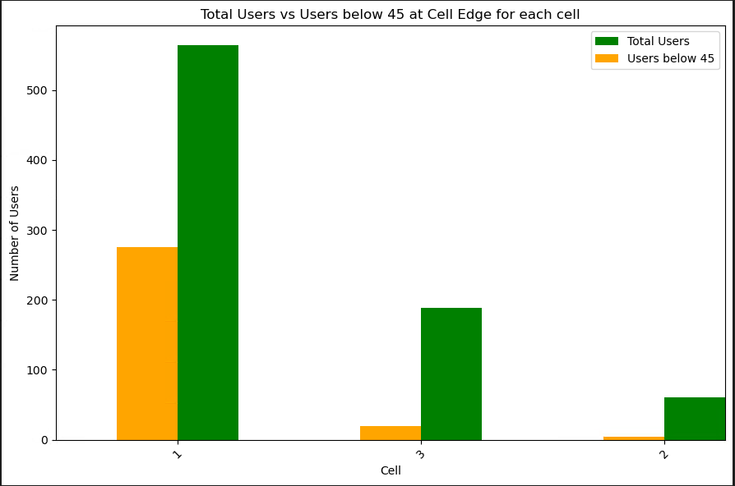
Exploratory Data Analysis

Slide 6

Exploratory Data Analysis

Slide 7
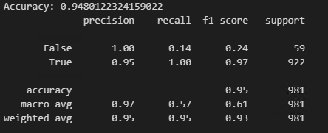
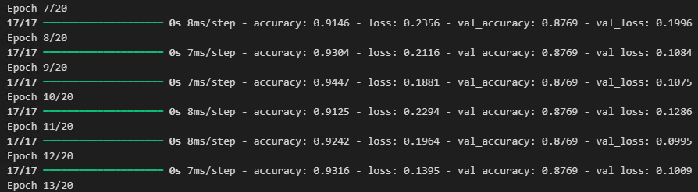
Model Implementation:
ML Model:
Model Deployment:
Deploy the trained deep learning model to the LTE network for real-time handover prediction and analysis of the field logs.
Deep learning Model:

Slide 8




Testing: Exploratory Data Analysis
Signal Quality
Cell Transitions
Temporal Factors
User Behavior
Analyze the distribution and trends of signal strength (RSRP, RSRQ) across successful and failed handovers.
Investigate the patterns and characteristics of cell-to-cell transitions during handover events.
Explore the impact of time-related variables, such as time of day or network load, on handover success rates.
Analyze user mobility patterns and their influence on handover performance.

Slide 9




Conclusion: Optimizing Handovers for Better Connectivity
Predictive Model
The developed deep learning-based model can accurately predict handover success rates, enabling proactive network management.
Handover Optimization
By leveraging the predictive model, network operators can fine-tune handover parameters and thresholds to improve overall connectivity.
Seamless User Experience
Optimizing handovers ensures a seamless user experience, with minimal disruptions during cell transitions.

Slide 10
References
Handover in LTE Networks
A comprehensive study on handover mechanisms and performance in LTE networks.
Handover Prediction in LTE Networks
A machine learning-based approach for predicting handover success in LTE networks.
Git Hub Link

Slide 11
Acknowledgments
Research Team
Industry Experts
Funding Support
We would like to acknowledge the contributions of our research team, including John Doe, Jane Smith, and Alex Johnson, for their invaluable insights and support throughout this project.
We are grateful for the guidance and feedback provided by our industry partners, who have shared their deep expertise in LTE network operations and optimization.
This work was made possible with the financial support of the XYZ Research Grant, which has enabled us to pursue this important research on handover optimization in LTE networks.

Slide 12




Future Directions
Adaptive Algorithms
Explore the development of adaptive handover algorithms that can dynamically adjust to changing network conditions and user mobility patterns.
Real-time Optimization
Investigate the integration of the predictive model into real-time network management systems for proactive handover optimization.
Further Enhancements
Expand the predictive model to predict RLF & power optimization.

